Slide 1
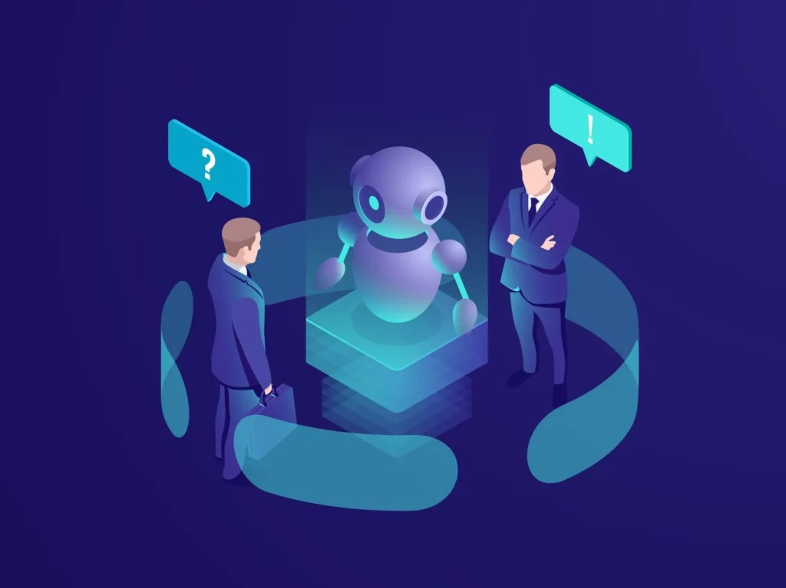
AI Based Candidates Recommending System For a Company Vacancy
Group ID : R25-040

Slide 2
Team Members
Group ID - R25-040
Supervisor - Prof. Samantha Thelijjagoda
Co-supervisor - Ms. Poorna Panduwawala
External-supervisor - Prof. Nishantha Giguruwa
Student Name | Student ID
K.T.A.D.K Kasthurirathna | IT21815614
R.S.K. De Silva | IT21834424
B.D.A.M Kumara | IT21819810
S.U.D.A Gunasekara | IT21838620

Slide 3
Introduction
In today's competitive job market, finding the right candidate goes beyond just evaluating resumes. Traditional hiring methods often fail to capture crucial soft skills such as confident, stress level, decision-making abilities, and engagement, which are essential for job success. Innovative solutions that ensure a more efficient, unbiased, and effective hiring process are essential to identify candidates who truly align with their organizational needs and culture.

Slide 4

Research Problem
How can we go beyond the traditional method of candidate selection for a company vacancy, which often fail to assess critical soft skills?
The limitation results in mismatches between job roles and candidates, leading to increased turnover rates and inefficiencies in the hiring process.

Slide 5
Research Objectives
To implement intelligent algorithms that provide personalized job-candidate matching based on a comprehensive skill assessment.
Detection of confident level by voice tone
Detection of stress by facial expressions
Detection of decision making skill by text analysis
Detection of engagement with their works

Slide 6
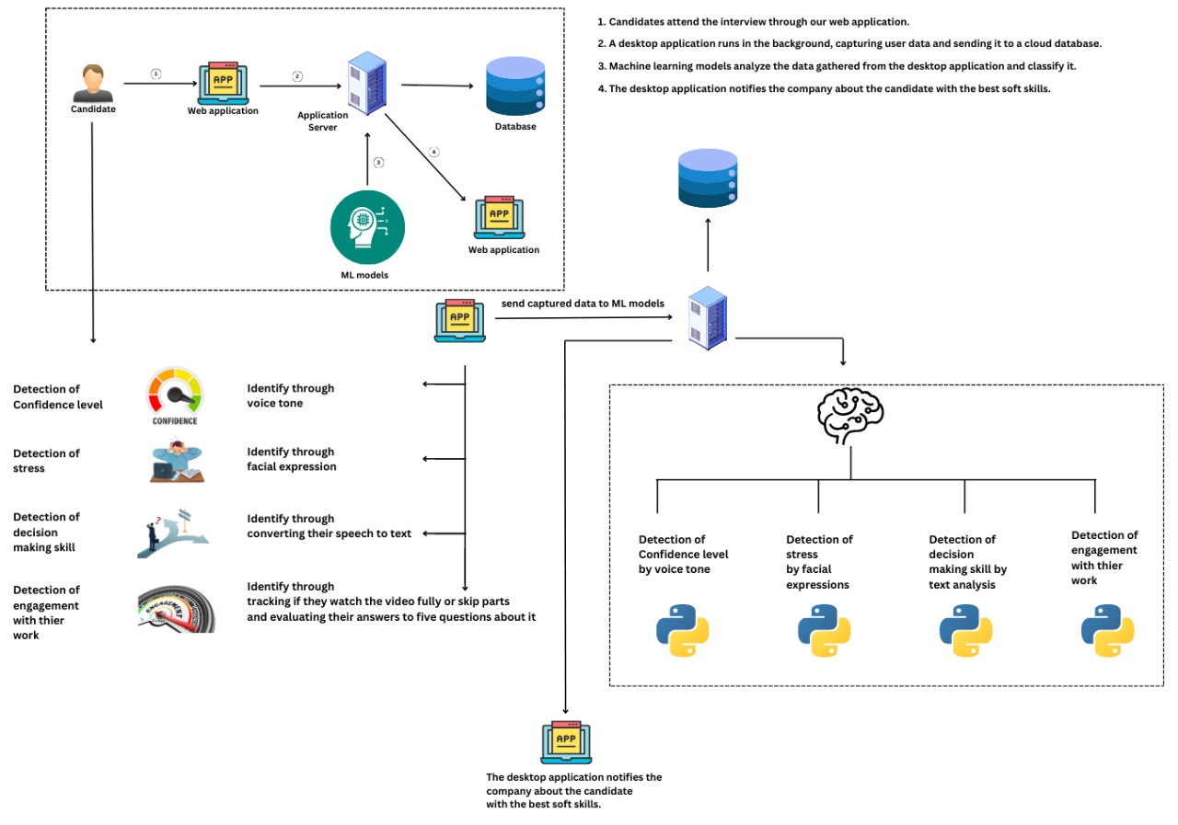
Overall System Diagram

Slide 7

IT21834424 | De Silva R.S.K
Bachelor of Science (Hons) in Information Technology
Specializing in Information Technology
IT21834424 | De Silva R.S.K | R025-040

Slide 8
Background
Why is it important to objectively assess a candidate’s confident level during the hiring process?
How can speech and tone analysis improve the accuracy and fairness of candidate evaluations compared to traditional interview methods?
IT21834424 | De Silva R.S.K | R025-040

Slide 9
Research Question
How can speech and tone analysis be effectively utilized to predict a candidate's confidence level during an interview?
IT21834424 | De Silva R.S.K | R025-040

Slide 10


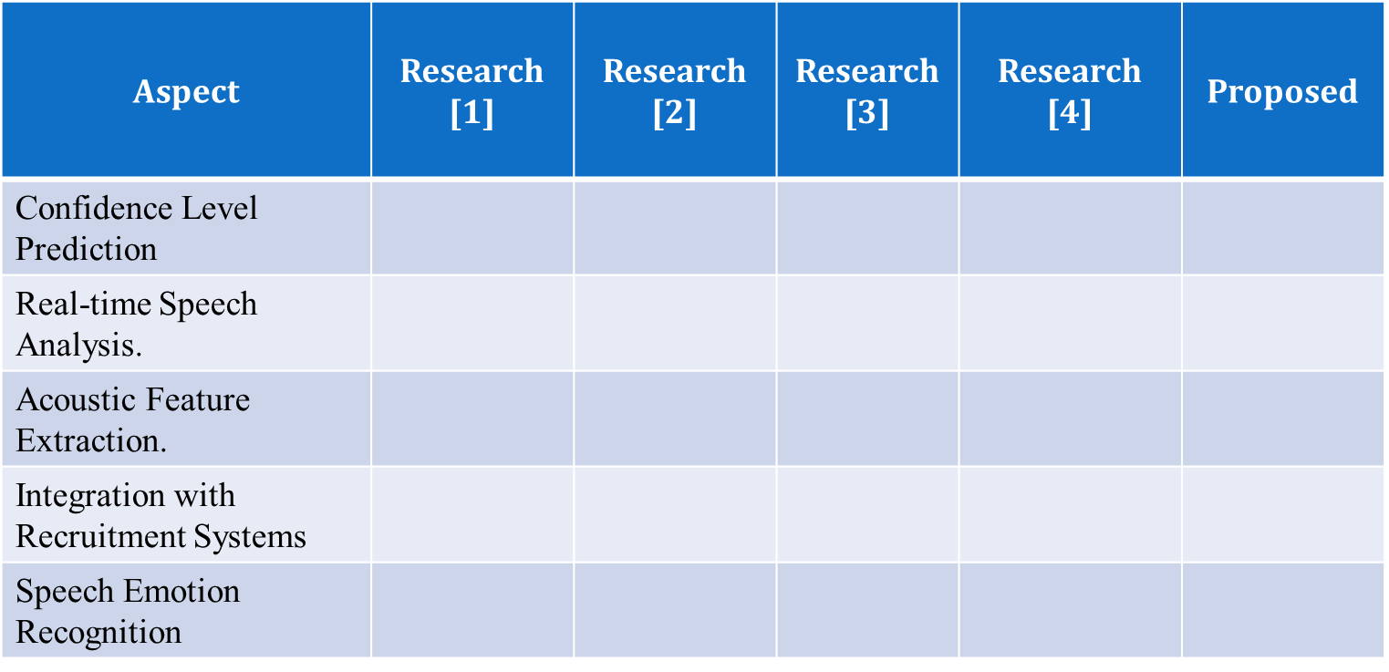

Research Gap
= Addressed by the research paper
= Not addressed by the research paper
IT21834424 | De Silva R.S.K | R025-040

Slide 11
Objectives
Specific Objective
Develop an AI-driven system that predicts a candidate's confidence level through speech and tone analysis during interviews.
Sub Objectives
Identify key acoustic features (e.g., pitch, intensity, modulation) that indicate confidence.
Develop machine learning models to analyze speech data and classify confidence levels.
Integrate the speech analysis model with an interview web application for real-time feedback.
Evaluate the accuracy and reliability of the proposed solution against human assessments.
IT21834424 | De Silva R.S.K | R025-040

Slide 12
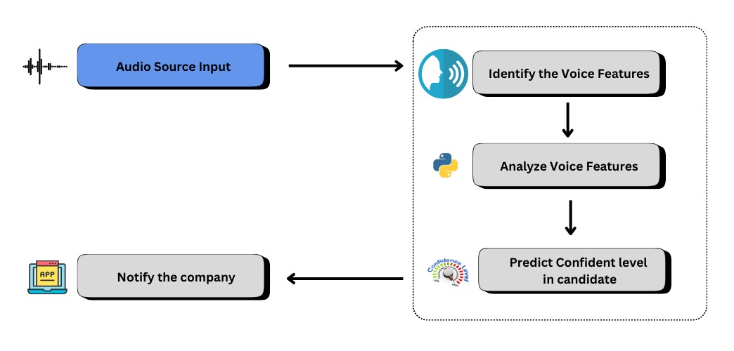
Proposed Solution
IT21834424 | De Silva R.S.K | R025-040

Slide 13
Requirements
Functional Requirements
The system must capture audio input during interviews.
The model should analyze speech characteristics and provide a confidence score.
The results should be displayed in a dashboard for recruiters.
Non-Functional Requirements
The system should process data in real-time with minimal latency.
Ensure data security and privacy for recorded speech samples.
The solution should be scalable to handle multiple concurrent interviews.
IT21834424 | De Silva R.S.K | R025-040

Slide 14
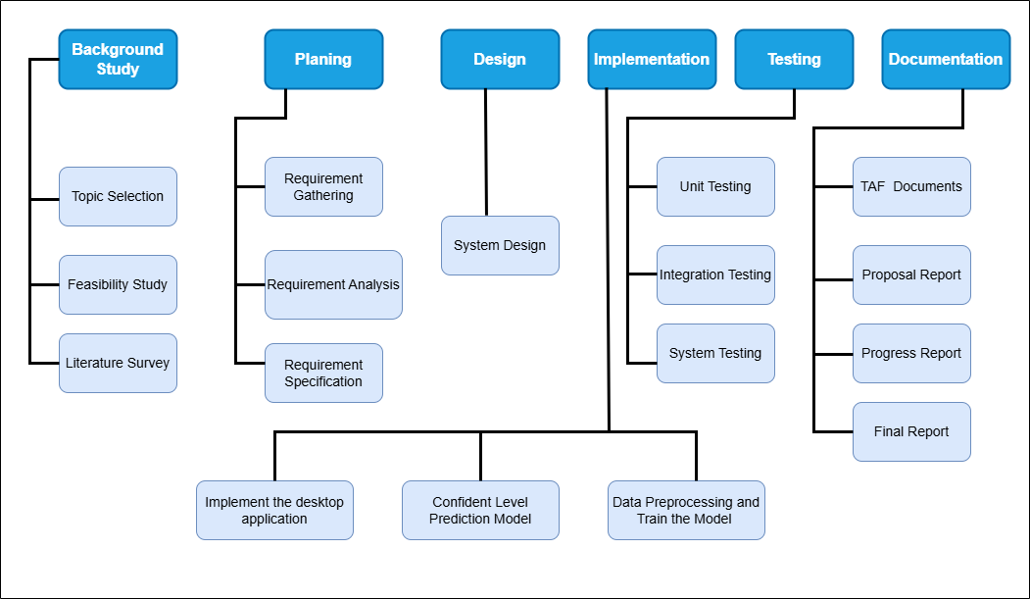
Work Breakdown Structure
IT21834424 | De Silva R.S.K | R025-040

Slide 15
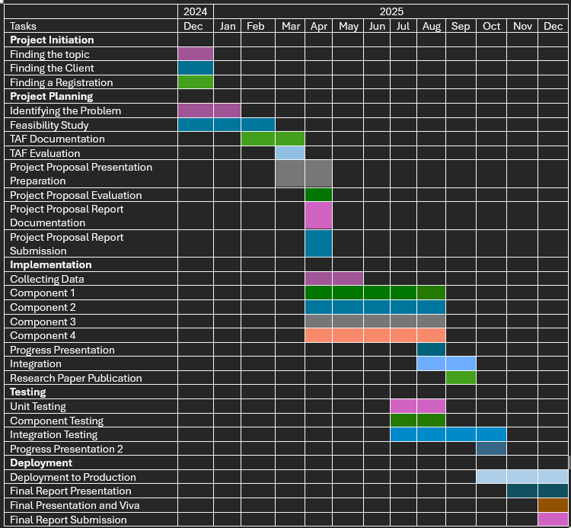
Gantt Chart
IT21834424 | De Silva R.S.K | R025-040

Slide 16










Tools & Technologies
IT21834424 | De Silva R.S.K | R025-040

Slide 17
References
[1] F. Eyben, M. Wöllmer, and B. Schuller, "openSMILE – The Munich Versatile and Fast Open-Source Audio Feature Extractor," in Proceedings of the 18th ACM International Conference on Multimedia, 2010, pp. 1459–1462. https://doi.org/10.1145/1873951.1874246
[2] J. D. Rojas and J. A. Bilmes, "Predicting Confidence and Doubt in Accented Speakers: Human Perception and Machine Learning Experiments," in Proceedings of Interspeech 2016, 2016, pp. 2150–2154.
https://doi.org/10.21437/Interspeech.2016-1426
[3] P. Boersma and D. Weenink, "Praat: Doing Phonetics by Computer," http://www.praat.org/
[4] B. Schuller et al., "Speech Emotion Recognition: State of the Art and Remaining Challenges," Cognitive Computation, vol. 10, no. 4, pp. 1–19, 2018. https://doi.org/10.1007/s12559-018-9522-2
IT21834424 | De Silva R.S.K | R025-040

Slide 18

IT21815614 | K.T.A.D.K Kasthurirathna
Bachelor of Science (Hons) in Information Technology
Specializing in Information Technology
IT21815614 | K.T.A.D.K Kasthurirathna | R025-040

Slide 19
Background
How does stress affect to their work during the working time?
How can we predict candidates' stress levels when facing serious job-related problems during an interview?
IT21815614 | K.T.A.D.K Kasthurirathna | R025-040

Slide 20
Research Question
"How can a machine learning model be designed to analyze facial expressions captured through a webcam to predict candidates' stress levels during interviews?"
"What are the key facial expression features (e.g., eye movement, eyebrow position, mouth shape) that can be used to accurately predict stress levels in candidates during real-time interviews?"
"How can real-time stress detection be integrated into an AI-based interview system to evaluate candidates' ability to handle high-pressure scenarios?"
IT21815614 | K.T.A.D.K Kasthurirathna | R025-040

Slide 21

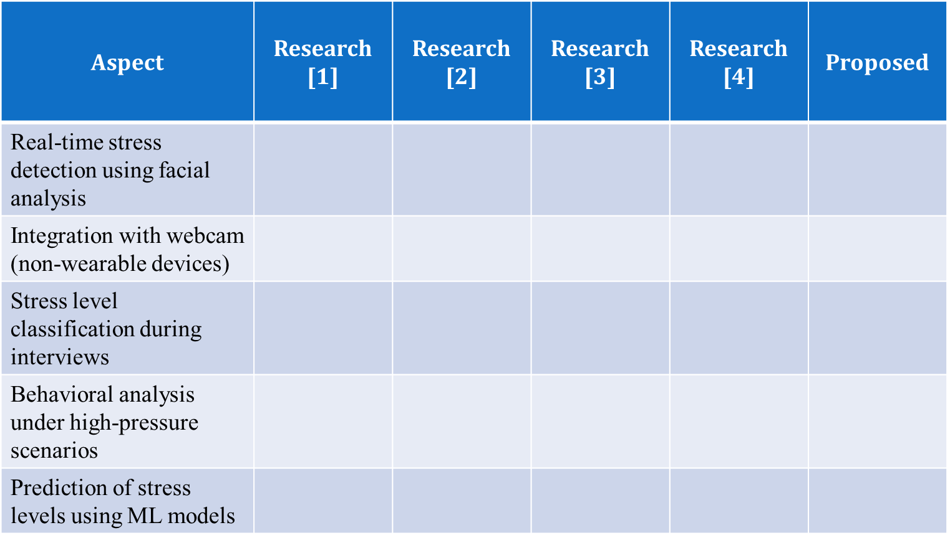
Research Gap
= Addressed by the research paper
= Not addressed by the research paper
IT21815614 | K.T.A.D.K Kasthurirathna | R025-040

Slide 22
Objectives
Specific Objective
To develop and implement a real-time system for predicting stress levels in candidates through facial expression analysis.
Sub Objective
To identify specific facial expression features, such as eye movements, mouth shape, and eyebrow positions, that are indicative of stress during interviews.
To design and train a machine learning model for analyzing facial expression features to predict stress levels accurately.
To validate the performance of the stress prediction model using real-time data captured through a webcam.
To integrate the stress detection model into an AI-based interview system that assesses candidates' stress responses in high-pressure scenarios.
IT21815614 | K.T.A.D.K Kasthurirathna | R025-040

Slide 23
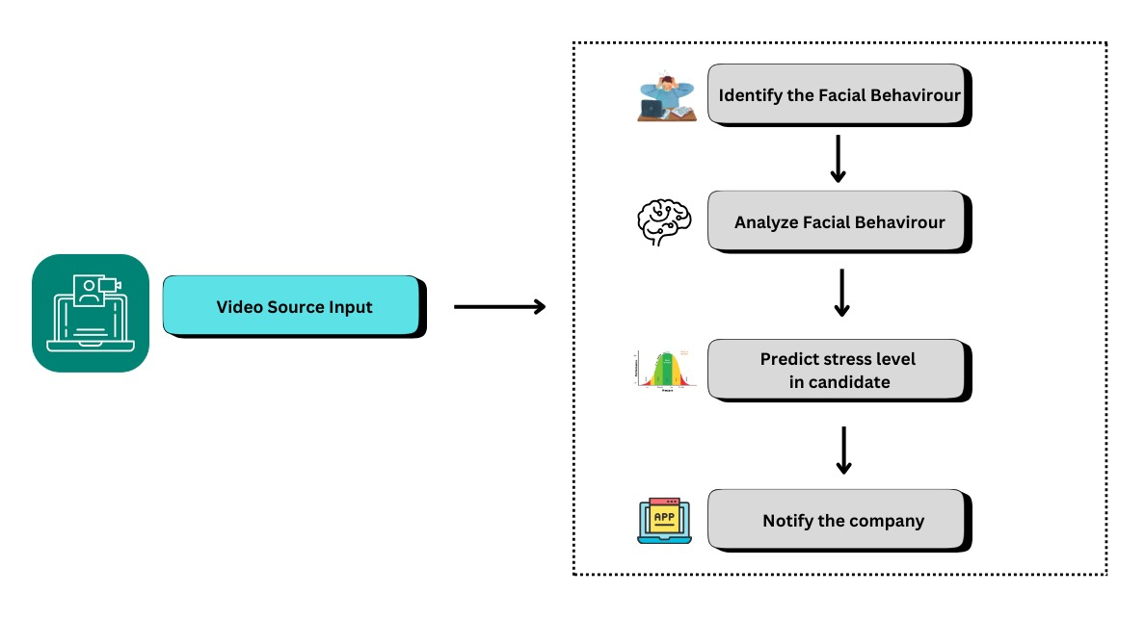
Proposed Solution
IT21815614 | K.T.A.D.K Kasthurirathna | R025-040

Slide 24
Requirements
Functional Requirements
Real-Time Facial Expression Analysis: The system should capture and analyze facial expressions of candidates in real time using a webcam.
Stress Level Prediction : The system should accurately predict the candidate's stress level based on facial indicators such as eye movement, eyebrow position, and mouth shape.
Machine Learning Integration : The system should integrate a trained machine learning model to analyze facial features and output stress levels.
Facial Feature Detection : The system should detect and extract key facial features (e.g., eye movements, frown lines) to identify stress-related patterns.
IT21815614 | K.T.A.D.K Kasthurirathna | R025-040

Slide 25
Non-Functional Requirements
Performance : The system should process and analyze facial data within a response time of less than 2 seconds to ensure real-time operation.
Accuracy : The stress detection model should achieve at least 90% accuracy in predicting stress levels based on facial expressions.
Scalability : The system should handle simultaneous analysis of multiple candidates in a group interview setting without performance degradation.
Usability : The user interface for the system should be intuitive and easy for recruiters to interpret stress-level predictions and reports.

Slide 26
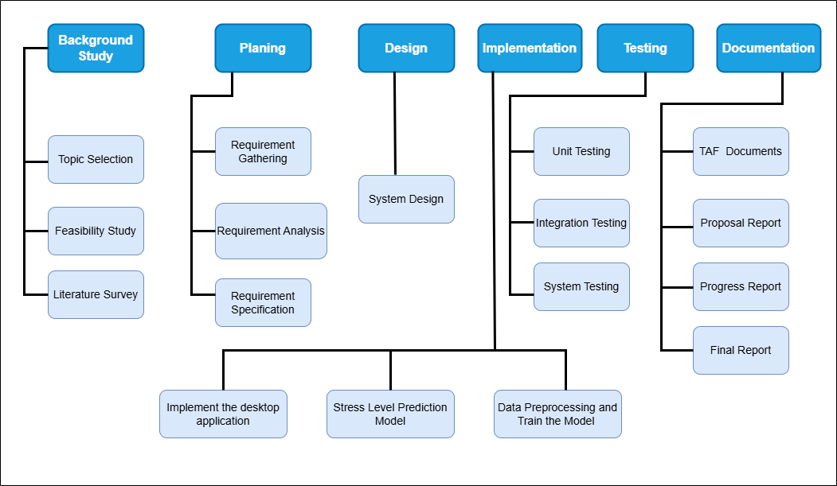
Work Breakdown Structure
IT21815614 | K.T.A.D.K Kasthurirathna | R025-040

Slide 27
Gantt Chart
IT21815614 | K.T.A.D.K Kasthurirathna | R025-040

Slide 28


Tools & Technologies
IT21815614 | K.T.A.D.K Kasthurirathna | R025-040

Slide 29
References
[1] A. S. Rathore, S. Mehta, and P. Gupta, "Real-Time Stress Detection and Analysis using Facial Emotion Recognition," International Journal of Advanced Research in Computer and Communication Engineering, vol. 10, no. 5, pp. 45-50, May 2021. https://ijarcce.com/papers/real-time-stress-detection-and-analysis-using-facial-emotion-recognition/.
[2] J. Zhang, Y. Shen, and H. Wang, "Real-Time Mental Stress Detection Using Multimodality Expressions," Frontiers in Neuroscience, vol. 16, no. 947168, pp. 1-10, Nov. 2022. https://www.frontiersin.org/journals/neuroscience/articles/10.3389/fnins.2022.947168/full.
[3] D. Thomas, R. Lee, and A. Park, "Real-Time Emotion Detection by Quantitative Facial Motion Analysis," Journal of Emotion and Computing, vol. 8, no. 2, pp. 45-52, Mar. 2023.
https://www.ncbi.nlm.nih.gov/pmc/articles/PMC10004542/.
[4] L. C. Smith and D. N. Patel, "Stress Detection of Autistic Adults during Simulated Job Interviews," Proceedings of the ACM Digital Library, vol. 22, no. 7, pp. 120-129, Oct. 2023.
https://dl.acm.org/doi/10.1145/3639709.
IT21815614 | K.T.A.D.K Kasthurirathna | R025-040

Slide 30

IT21838620 | S.U.D.A Gunasekara
Bachelor of Science (Hons) in Information Technology
Specializing in Information Technology
IT21838620 | S.U.D.A Gunasekara | R025-040

Slide 31
Background
How can candidate’s decision-making skills detect by analyzing speech to text approach ?
What are the potential advantages over face-to-face traditional interviewing methods ?
What kind of decision-making skills important for the job description ?
IT21838620 | S.U.D.A Gunasekara | R025-040

Slide 32
Research Question
How can speech-to-text technology be leveraged to analyze decision-making skills in real-time job interviews?
How accurate are speech-to-text systems in capturing and analyzing decision-making content under varying linguistic and environmental conditions?
Can speech-to-text analysis be integrated into AI-based candidate recommendation systems for behavioral evaluation?
IT21838620 | S.U.D.A Gunasekara | R025-040

Slide 33


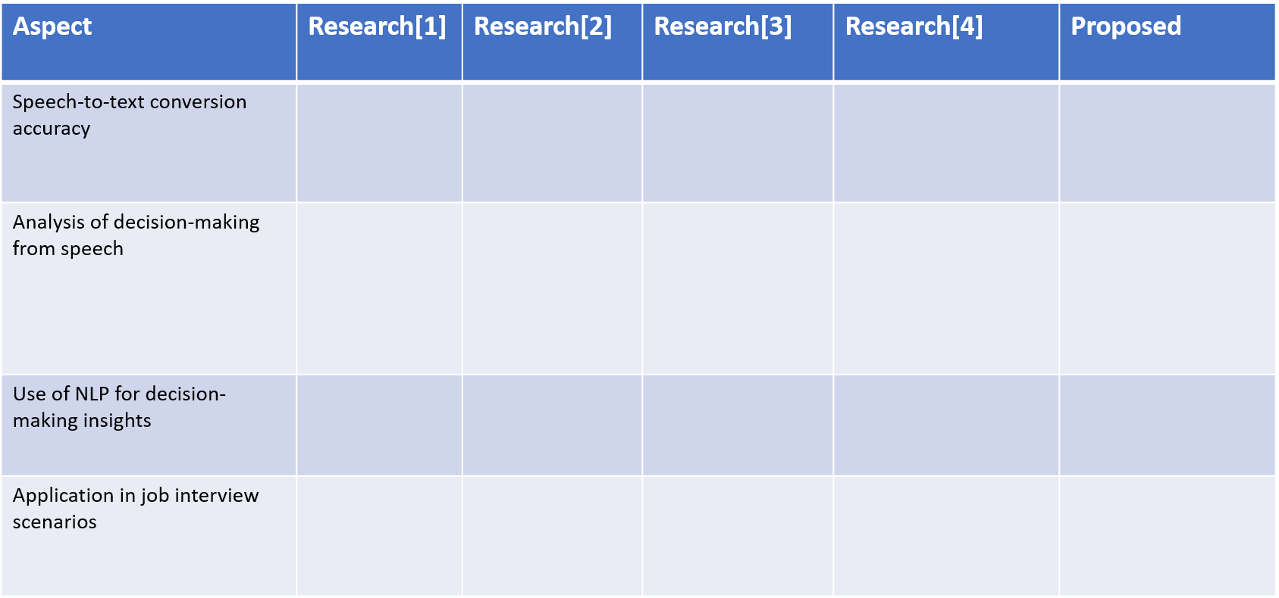
Research Gap
= Addressed by the research paper
= Not addressed by the research paper
IT21838620 | S.U.D.A Gunasekara | R025-040

Slide 34
Objectives
Specific Objective
Develop a robust framework for detecting and evaluating candidates' decision-making skills during interviews by analyzing speech-to-text data using advanced natural language processing (NLP) techniques and machine learning models, ensuring an objective, real-time, and reliable assessment method.
Sub Objectives
To process speech-to-text data.
To analyze decision-making patterns in text
To predict decision-making proficiency using AI
To design a scoring mechanism for decision-making skills
To validate the proposed decision-making evaluation system.
IT21838620 | S.U.D.A Gunasekara | R025-040

Slide 35
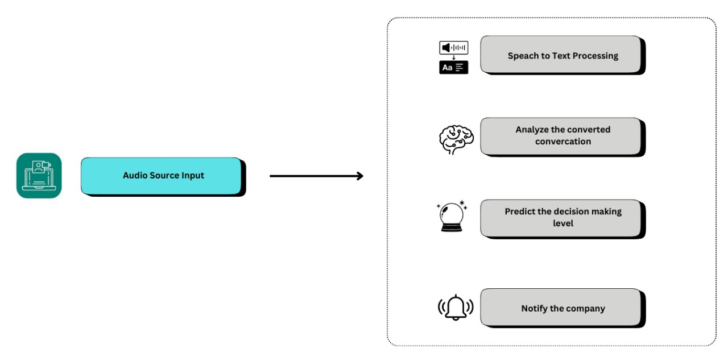
Proposed Solution
IT21838620 | S.U.D.A Gunasekara | R025-040

Slide 36
Requirements
Functional Requirements
Speech-to-Text Conversion
Decision-Making Detection
Contextual Analysis
Machine Learning Integration
Real-time Analysis
Non-Functional Requirements
Performance
Scalability
Security
Usability
Reliability
Compatibility
IT21838620 | S.U.D.A Gunasekara | R025-040

Slide 37

Work Breakdown Structure
IT21838620 | S.U.D.A Gunasekara | R025-040

Slide 38
Gantt Chart
IT21838620 | S.U.D.A Gunasekara | R025-040

Slide 39


Tools & Technologies
IT21838620 | S.U.D.A Gunasekara | R025-040

Slide 40
References
[1] A. Agrawal, S. Chakraborty, and K. Ghosh, "Analyzing Behavioral Cues in Video Interviews for Candidate Assessment," arXiv preprint arXiv:2006.07909, 2020. https://arxiv.org/abs/2006.07909.
[2] B. Niemitz and A. Wihler, "The (null) effects of video questions on applicant reactions in asynchronous video interviews: Evidence from an actual hiring context," International Journal of Selection and Assessment, vol. 32, no. 1, pp. 1–15, 2024.
https://onlinelibrary.wiley.com.
[3] M. Abdullah, K. Alissa, and O. Alzoubi, "New user engagement prediction using machine learning algorithms," 2023 14th International Conference on Information and Communication Systems (ICICS), Irbid, Jordan, Nov. 21–23, 2023, pp. 1–6. https://doi.org/10.1109/ICICS60529.2023.10330488.
[4] R. T. Khan, M. S. Rizvi, and S. A. Singh, "Predictive analytics for job candidate assessment: Developing a holistic scoring model," International Journal of Human-Computer Interaction, vol. 38, no. 5, pp. 112–125, 2022.
https://doi.org/10.1080/10447318.2021.1980763
IT21838620 | S.U.D.A Gunasekara | R025-040

Slide 41

IT21819810 | B.D.A.M Kumara
Bachelor of Science (Hons) in Information Technology
Specializing in Information Technology
IT21819810 | B.D.A.M Kumara | R025-040

Slide 42
Background
How can video engagement analysis be utilized as an objective tool to assess candidates' soft skills?
what are the potential advantages over traditional interview methods?
IT21819810 | B.D.A.M Kumara | R025-040

Slide 43
Research Question
How can video engagement metrics help us understand a candidate's focus and engagement?
How does a candidate’s engagement with the video relate to their task performance?
How can AI tools predict engagement levels during the interview?
How can we create a scoring model that combines video engagement and task performance?
IT21819810 | B.D.A.M Kumara | R025-040

Slide 44
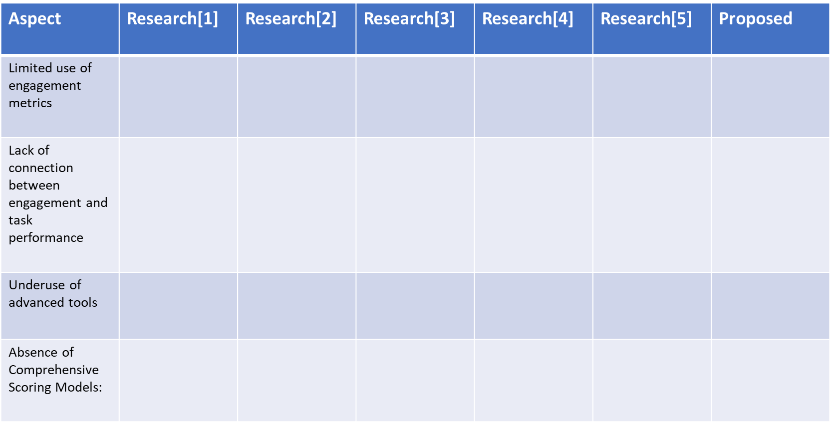
Research Gap
= Addressed by the research paper
= Not addressed by the research paper
IT21819810 | B.D.A.M Kumara | R025-040

Slide 45
Objectives
Specific Objective
To develop a method for analyzing soft skills during interviews by combining video engagement metrics and task performance data, using AI tools to make the analysis more accurate.
Sub Objectives
Analyze video engagement metrics, like video completion and skipping behavior.
Measure how well candidates perform on multiple-choice questions, such as accuracy
Use AI to predict engagement levels (High, Moderate, Low).
Design a scoring system that combines video engagement (40%) and task performance (60%).
Test the method with real-world data.
IT21819810 | B.D.A.M Kumara | R025-040

Slide 46
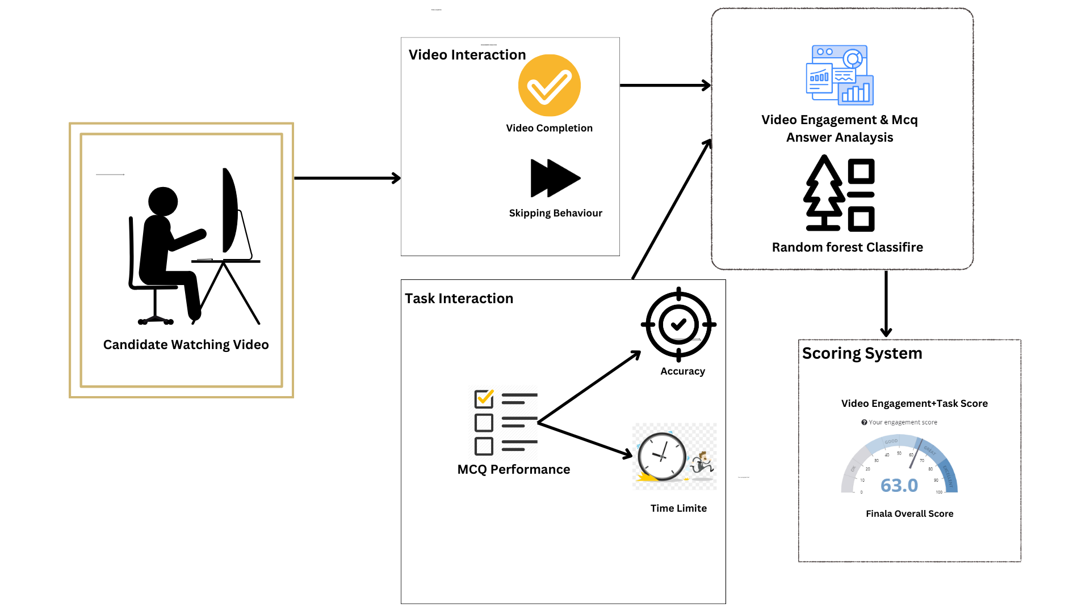
Proposed Solution
IT21819810 | B.D.A.M Kumara | R025-040

Slide 47
Requirements
Functional Requirements
Video Interaction Tracking
MCQ Performance Monitoring
Engagement Metrics Computation
Machine Learning Integration
Real-time Feedback
Non-Functional Requirements
Performance
Scalability
Security
Usability
Reliability
Compatibility
IT21819810 | B.D.A.M Kumara | R025-040

Slide 48

Work Breakdown Structure
IT21819810 | B.D.A.M Kumara | R025-040

Slide 49
Gannt Chart
IT21819810 | B.D.A.M Kumara | R025-040

Slide 50





Tools & Technologies
IT21819810 | B.D.A.M Kumara | R025-040

Slide 51
References
[1] A. Agrawal, S. Chakraborty, and K. Ghosh, "Analyzing Behavioral Cues in Video Interviews for Candidate Assessment," arXiv preprint arXiv:2006.07909, 2020.
https://arxiv.org/abs/2006.07909.
[2] B. Niemitz and A. Wihler, "The (null) effects of video questions on applicant reactions in asynchronous video interviews: Evidence from an actual hiring context," Int. J. Select. Assess., vol. 32, no. 1, pp. 1–15, 2024.
https://onlinelibrary.wiley.com
[3]M. Abdullah, K. Alissa, and O. Alzoubi, "New user engagement prediction using machine learning algorithms," 2023 14th International Conference on Information and Communication Systems (ICICS), Irbid, Jordan, 21-23 Nov. 2023, pp. 1-6. https://doi.org/10.1109/ICICS60529.2023.10330488. ISBN: 979-8-3503-0786-3, ISSN: 2573-3346.
[4]R. T. Khan, M. S. Rizvi, and S. A. Singh, "Predictive analytics for job candidate assessment: Developing a holistic scoring model," Int. J. Hum.-Comput. Interact., vol. 38, no. 5, pp. 112–125, 2022, doi: 10.1080/10447318.2021.1980763.
[5] A. Khan et al., "The Impact of Employee Engagement on Task Performance," International Journal of Business and Management, vol. 13, no. 5, pp. 74–84, 2018.
https://www.academia.edu/96376169.
IT21819810 | B.D.A.M Kumara | R025-040

Slide 52
CommErcialization
Our main target audience is companies which hire candidates.
Market the system under affordable price with a web camera and a microphone.

Slide 53
Data sets to be used:
Detect Confident: (Kaggle) https://www.kaggle.com/datasets/swarupakulkarni/voice-based-confidence-recognizer?utm_source=chatgpt.com
Detect Stress Level: (Kaggle) https://www.kaggle.com/datasets/msambare/fer2013
Detect Decision Making Skill:(AMI meeting groups) https://groups.inf.ed.ac.uk/ami/download/
Detect Engagement Skill:(Mendeley data) https://www.selectdataset.com/dataset/c5a2fbdb76db33f357c4f05a3f58a0fc
https://paperswithcode.com/dataset/im-sportingbehaviors

Slide 54
Thank You !

